Slide 1

AI FOR CRYPTOCURRENCY INVESTIGATIONS

Slide 2


Presenter Name:
Crispen Masunda – Financial Investigative Analyst IRS CI
Background:
MSc in Computational Operations Research, William & Mary
BA in Economics & Mathematics, Oberlin College
Presenter Name:
Wendy Hlebinsky – Forensic Accountant IRS CI
Background:
Masters in Accountancy, Old Dominion University
BA in Public and Urban Affairs, Virginia Tech
Machine Learning in Investigations: Cryptocurrency Analytics: ~ 25 mins Money Laundering – Automating the identification of illicit transactions on the blockchain Questions ~ 5 mins

Slide 3
INTRODUCTION

Slide 4
3PML Use Case
Problem & Motivation
Due to the regulation challenges that Blockchain technology brings to 3PML cases, there is need for more advanced analytics on major cryptocurrencies (Bitcoin, Ethereum, Zcash, Monero etc.).
Illicit actors are frequently using cryptocurrencies to obfuscate their dealings.
Goal: flagging illicit transactions retroactively and in real time
Requirement
Need to find a way to classify the illicit actors/transactions on these crypto networks.
Robust, fast and scalable solution
Methods
Feature Engineering
Graph Analytics
Supervised Machine Learning
Light Gradient Boosting Machines

Slide 5
Why is this Work Important
The methods discussed in this presentation are at the core of accelerating lead generation work
Accelerated Lead Generation System
Automated Cryptocurrency Tracing
Automated Illicit Transaction Flagging

Slide 6
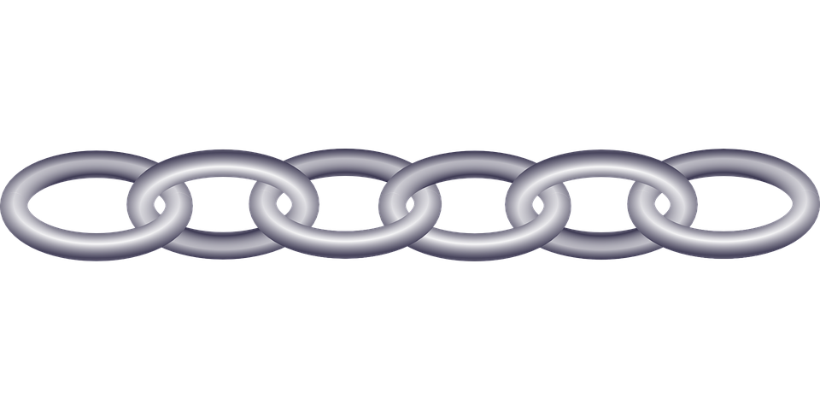
What is Blockchain
Distributed immutable database of asset ownership
Block 1: Genesis Block
Block 2
Block 3
Block 4
Block 5
…
Immutable and Permanent
Distributed and Decentralized
The Good and the Bad
Positive Applications of Blockchain Technology:
Voting
Cryptocurrencies (Bitcoin, Ethereum etc.)
Tax Returns
Supply Chain
Diplomas, Death Certificates, Title Deeds etc.
Dark Side of Blockchain Technology:
Silk Road – Dark Web Marketplace
Colonial Pipeline Ransomware Attack
Key Blockchain Features
Security
Group Consensus
Trustless

Slide 7
Analytic Process Overview
Highlighting analytic pipeline for the system
1. Data Ingestion & Processing
2. Variable Engineering & Exploratory Analysis
3. Model Training
4. Model Validation & Evaluation
Labelled Raw Data
Graph Analytics
Labelled Data
Model Performance and Generalizability Metrics
Loading Data in Analytic Environment
Add More Data Variables
Machine Learning Model
Predictions
On Hold Out
Dataset
Trained Model Prediction
Python Environment
Basic Statistics
Data from Feature Engineering
Illicit Transaction Predictions
RAW DATA
DATA PROCESSING
MACHINE LEARNING MODEL
MODEL EVALUATION

Slide 8
1. Data Ingestion and Processing

Slide 9
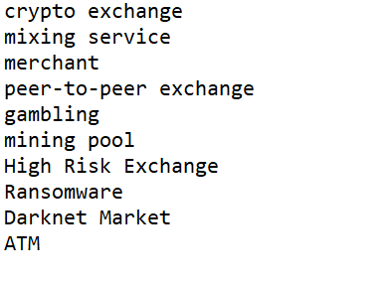
RAW INPUT DATA
Snapshot of what the raw data looks like

Slide 10
Partitioning the data for Training and Testing
Train data used to train the model and calibrate the weights. The test data is used as a hold out set that the model has not seen, symbolizing future data.

Slide 11
2. Variable Engineering

Slide 12
Variable Engineering
Process of generating new data variables from existing ones in the raw data. This is to give more information that enables the machine learning model to detect patterns.
BASIC METRICS
GRAPH ANALYTICS
Maximum Transaction Amounts
Minimum Transaction Amounts
Cumulative Transaction Amounts
Transaction Month
Transaction Day of The Week
Transaction Year
Transaction Hour
Duration of Account
Community Detection:
Transaction Triangle Counts
Clustering Wallets
Number of Incoming Transactions
Number of Outgoing Transactions
Total Number of transactions (both outgoing and incoming)
Wallet Importance Ranking (Google Algorithm)
Degrees of separation to a set of illicit wallets
Answer whether a wallet is connected to any set of wallets

Slide 13
Graph Analytics in Money Laundering
Why Graph Analytics
Graph Algorithms
Harnessing the research and progress made in the field of graph analytics.
Why Graph Analytics is Needed
Capturing Topological Relationships
Making the analytics to be 2D in that topological relationships and direction of flow of funds are used in addition to the traditional cross-sectional data from transactions.
Speed
Representing financial transaction data as a graph allows for highly specialized and optimized graph algorithms to be used to compute metrics and other analyses.
Can handle Big Data at great speed

Slide 14
BLOCKCHAIN GRAPH
We start off by defining the blockchain graph network. A graph is a structure that depicts the relationship between pairs of objects, symbolized by a link between them. Defining the blockchain network as a graph allows us to factor in the underlying relationships in our modeling exercise.
GRAPH ANALYTICS
Wallet 1
Transfer To
Transfer To
Wallet 2
Wallet 3
Transfer To
Wallet 4
Community Detection:
Transaction Triangle Counts
Clustering Wallets
Number of Incoming Transactions
Number of Outgoing Transactions
Total Number of transactions (both outgoing and incoming)
Wallet Importance Ranking - PageRank (Google Search Algorithm)
Answer whether a wallet is connected to any set of wallets
Degrees of separation to illicit nodes
Transfer To
Transfer To
Transfer To
Wallet 5
Transfer To
Wallet 6
Notes:
Robby

Slide 15
3. Model Training
Notes:
ethan

Slide 16
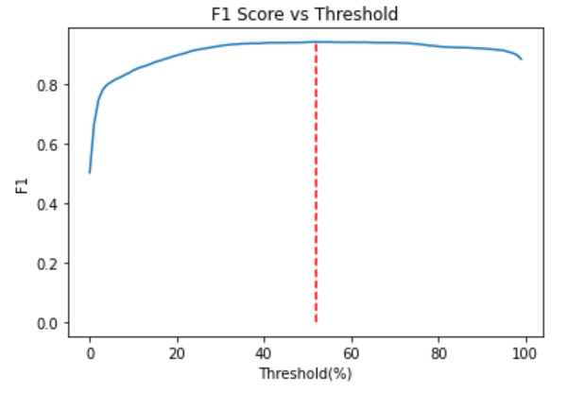
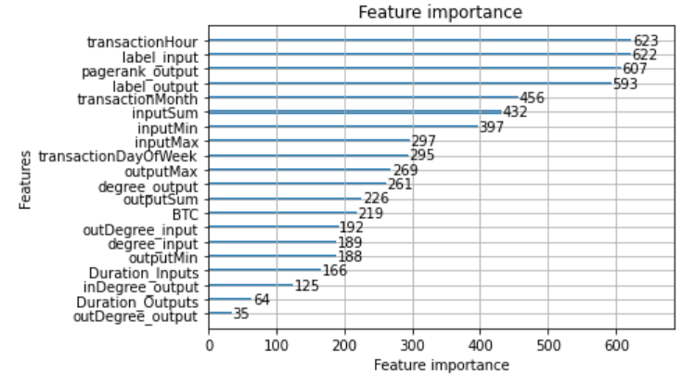
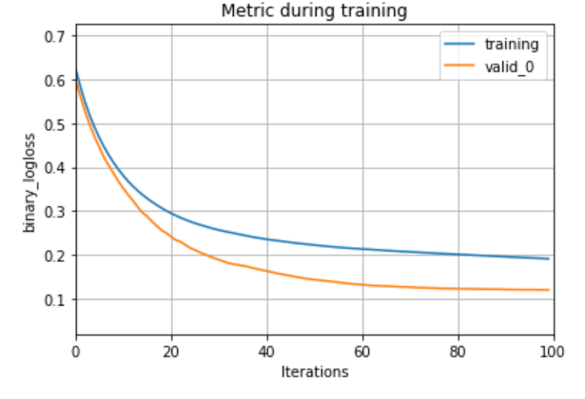
Model Output
The model ranks the most important features (variables) in the model as depicted below
Relative Variable Importance
Variables
Variable Importance Score

Slide 17
4. Model Validation & Evaluation
Notes:
ethan

Slide 18
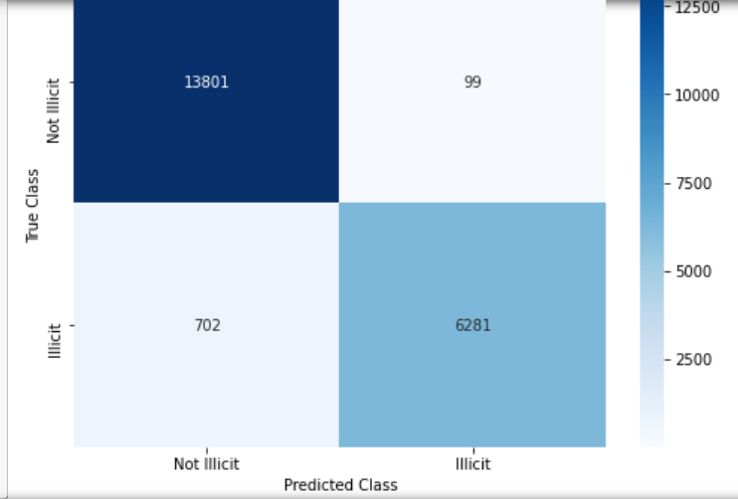
Prediction on Unseen Data
Evaluating how the model would generally perform on data that it hasn’t seen during the training (i.e. future data). For all 20,883 transactions in this dataset, we know whether each transaction is illicit or licit
Confusion Matrix
Stats
90%
Accurately Predicted Illicit Transactions
99%
Accurately Predicted licit Transactions
96%
Overall prediction accuracy
13,900 licit
6,983 illicit
Transactions in Dataset

Slide 19
Bringing It All Together
In Summary
Accelerated Lead Generation System
Automated Cryptocurrency Tracing
Automated Illicit Transaction Flagging

Slide 20
Questions
Notes:
ethan

